Slide 1
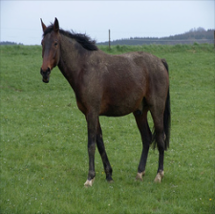

Horse-to-Zebra CycleGAN with Segmentation-guided Attention
Deep Learning and its applications to Signal and Image Processing and Analysis
Project Presentation
Under the supervision of Prof. Tammy Riklin Raviv
Students:
Daniel Manor, Lior Yaacov

Slide 2


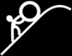

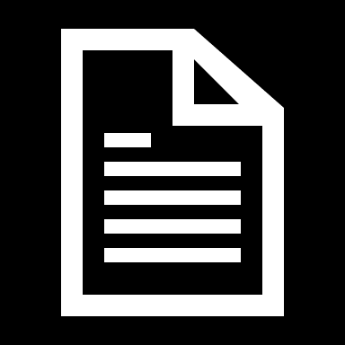
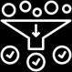

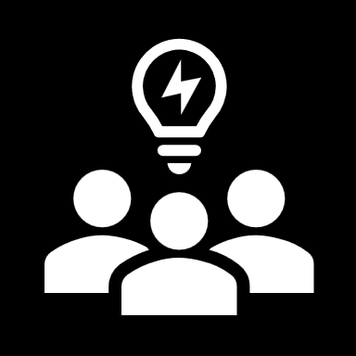


Agenda
1
Introduction
Challenge and dataset overview
2
Architectures
GANs, Cycle-GANs and Patch-GANs overview
3
Related Work
Method
CycleGAN with Segmentation-guided Attention
4
Models
Results
Model’s results and comparisons
5
Conclusions
Summarizing and Future Directions

Slide 3
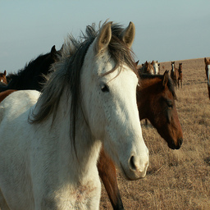
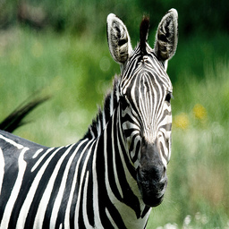
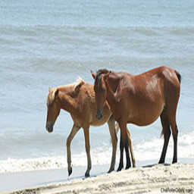
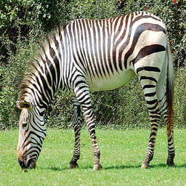
The Challenge
Transform images from the horse domain to look like realistic zebras
Unpaired Images = Unsupervised Learning
No exact zebra counterpart is available for each horse image
Key Challenge: How to learn a meaningful mapping between horse and zebra domains without paired examples?

Slide 4
The Dataset
The Horse2zebra dataset contains unpaired images of horses and zebras
Images in both the domains are split into train and test subsets
Images size are 256x256 pixels
As can be seen in the bar plot below, the dataset is quite balanced

Slide 5
GANs
Introduced by Ian Goodfellow et al. in 2014
Comprises two neural networks:
Generator: Creates synthetic data
Discriminator: Evaluates the authenticity of the data
The two networks compete, improving each other iteratively
Requires aligned image pairs for tasks like image translation
Sample
Generator
Fake
Discriminator
Real or Fake
Real Image
Notes:
it typically requires paired data to learn a direct mapping between two domains.
In paired data, each input image (e.g., a horse) has a corresponding target image (e.g., a zebra) that represents the desired outcome after translation.
הארכי דורשת מיפוי ברור בין מרחב הכניסה למרחב היציאה אשר נלמד באמצעות זוגות

Slide 6
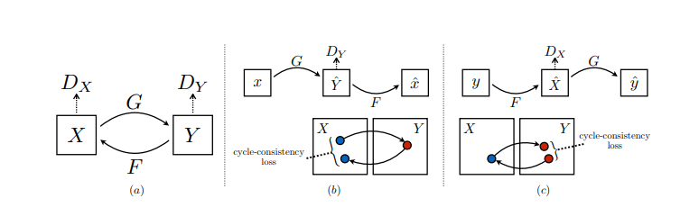
Cycle-GANs
Translates between two domains without requiring paired datasets.
Architecture Components:
Two Generators:
G: Translates images from Domain X (Horses) to Domain Y (Zebras).
F: Translates images from Domain Y (Zebras) back to Domain X (Horses).
Two Discriminators:
D_Y: Differentiates between real and generated Zebras.
D_X: Differentiates between real and generated Horses.

Slide 7
Cycle-GANs
Cycle Consistency Loss:
Ensures that translating an image to the target domain and back results in the original image.
Method:
Forward Cycle Consistency
Backward Cycle Consistency
Total Cycle Consistency loss

Slide 8
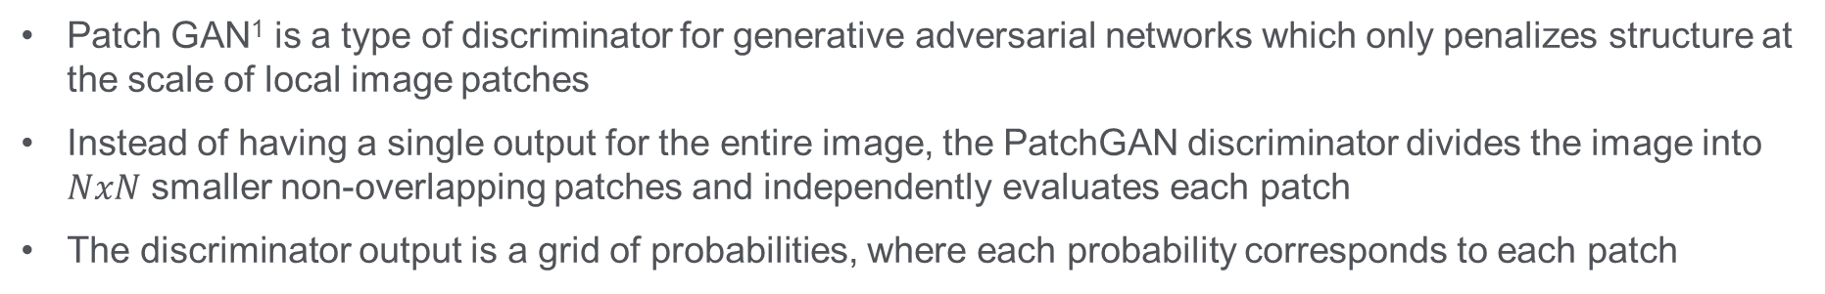
Patch-GANs
Patch GAN¹ is a type of discriminator for generative adversarial networks which only penalizes structure at the scale of local image patches
Instead of having a single output for the entire image, the PatchGAN discriminator divides the image into $NxN$ smaller non-overlapping patches and independently evaluates each patch
The discriminator output is a grid of probabilities, where each probability corresponds to each patch
GAN
True/False
0.09 | 0.12 | 0.57 | 0.16 | 0.49 | 0.49
0.18 | 0.88 | 0.37 | 0.47 | 0.74 | 0.89
0.91 | 0.32 | 0.32 | 0.99 | 0.88 | 0.17
0.24 | 0.07 | 0.08 | 0.74 | 0.46 | 0.87
0.16 | 0.85 | 0.55 | 0.02 | 0.67 | 0.93
0.35 | 0.76 | 0.15 | 0.66 | 0.82 | 0.97
Patch GAN
¹ Image-to-Image Translation with Conditional Adversarial Networks, Phillip Isola et al. - https://arxiv.org/pdf/1611.07004v3 (2018)

Slide 9
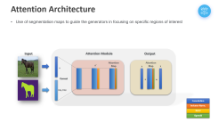
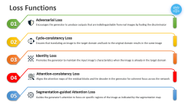
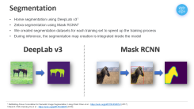
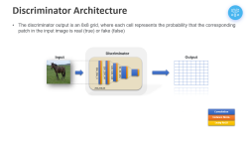
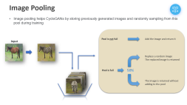
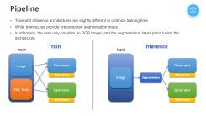
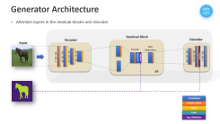



CycleGAN with Segmentation-guided Attention
In our work, we want to leverage segmentation maps for better image generation
Using the segmentation map as-is, i.e., blend the output image with parts from the original one results in bad images, as the segmentation is not robust enough
We propose to use segmentation to better focus the model over relevant areas (i.e., horses)

Slide 10
Pipeline
Train and Inference architectures are slightly different to optimize training time
While training, we provide precomputed segmentation maps
In inference, the user only provides an RGB image, and the segmentation takes place inside the architecture
Train
Inference
Input
Input
Image
Generator
Generator
Image
Attention
Segmentation
Attention
Seg. Map
Generator
Generator
Attention
Attention

Slide 11
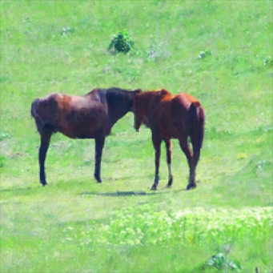

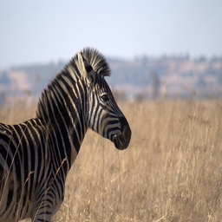
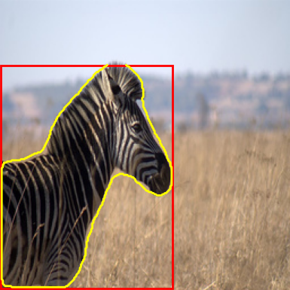
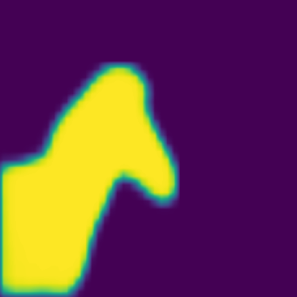
Segmentation
Horse segmentation using DeepLab v3¹
Zebra segmentation using Mask RCNN²
We created segmentation datasets for each training set to speed up the training process
During inference, the segmentation map creation is integrated inside the model
DeepLab v3
Mask RCNN
¹ Rethinking Atrous Convolution for Semantic Image Segmentation, Liang-Chieh Chen et al. - https://arxiv.org/pdf/1706.05587v3 (2017)
² Mask R-CNN, Kaiming He et al. - https://arxiv.org/pdf/1703.06870 (2018)

Slide 12
Generator Architecture
Attention layers in the residual blocks and decoder
Residual Block
Encoder
Decoder
Input
Dim
Reduction
Attention
Concat
64 , 64 , 256
Convolution
Attention
256 , 256 , 64
128 , 128 , 128
128 , 128 , 128
256 , 256 , 3
256 , 256 , 64
256 , 256 , 3
x9
Convolution
Instance Norm.
ReLU
TanH
Seg. Attention

Slide 13
Attention Architecture
Use of segmentation maps to guide the generators in focusing on specific regions of interest
Input
Attention Module
Output
Attention
Map
Attention
Map
x'
x
x
x
Concat
*
+
seg_map
Convolution
Instance Norm.
ReLU
Sigmoid

Slide 14
Discriminator Architecture
The discriminator output is an 8x8 grid, where each cell represents the probability that the corresponding patch in the input image is real (true) or fake (false)
Discriminator
Input
Output
64 , 64 , 256
128 , 128 , 128
256 , 256 , 64
256 , 256 , 3
256,256,64
Convolution
Instance Norm.
Leaky ReLU

Slide 15
Discriminator Architecture
The discriminator output is an 8x8 grid, where each cell represents the probability that the corresponding patch in the input image is real (true) or fake (false)
Discriminator
Input
Output
64 , 64 , 128
128 , 128 , 64
32 , 32 , 256
8 , 8 , 512
16 , 16 , 512
Convolution
Instance Norm.
Leaky ReLU

Slide 16
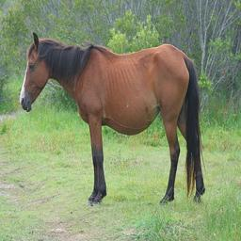
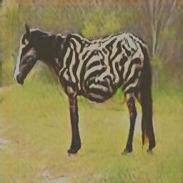
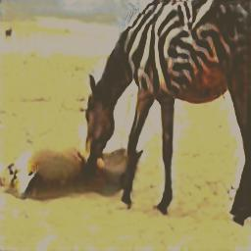
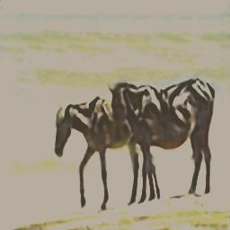
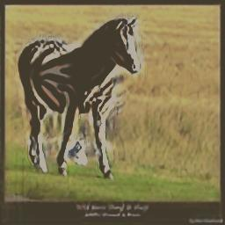
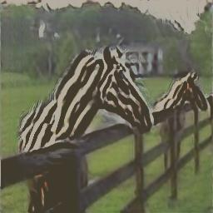
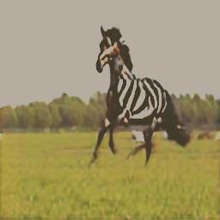
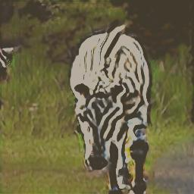
Image Pooling
Image pooling helps CycleGANs by storing previously generated images and randomly sampling from this pool during training
Input
Pool is not full
Add the image and return it
Replace a random image
The replaced image is returned
Pool is full
50%
The image is returned without adding to the pool

Slide 17





Loss Functions
01
Adversarial Loss
Encourages the generator to produce outputs that are indistinguishable from real images by fooling the discriminator
02
Cycle-consistency Loss
Ensures that translating an image to the target domain and back to the original domain results in the same image
03
Identity Loss
Promotes the generator to maintain the input image's characteristics when the image is already in the target domain
04
Attention-consistency Loss
Aligns the attention maps of the residual blocks and the decoder in the generator for coherent focus across the network
05
Segmentation-guided Attention Loss
Guides the generator's attention to focus on specific regions of the image as indicated by the segmentation map

Slide 18

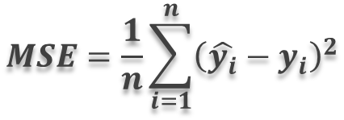



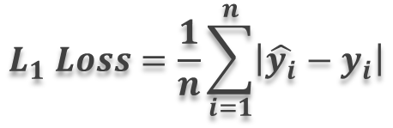
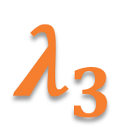



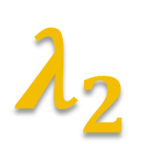

Loss Functions
$$MSE=\frac{1}{n}\sum_{i=1}^{n}{{\left(\hat{y_{i}}−y_{i}\right)}^{2}}$$
$$L_{1} Loss=\frac{1}{n}\sum_{i=1}^{n}{\left|\hat{y_{i}}−y_{i}\right|}$$
Cycle-consistency Loss
Adversarial Loss
Identity Loss
Attention-consistency Loss
Segmentation-guided Attention Loss
$$λ_{1}$$
Adversarial Loss
$$λ_{2}$$
Cycle
Consistency
$$λ_{3}$$
Identity
$$+$$
$$+$$
$$+$$
$$λ_{4}$$
Attention
Consistency
$$λ_{5}$$
Segmentation
-guided
Generator Loss
$$+$$
$$+$$
$$=$$
Notes:
loss_G = loss_G_A + loss_G_B + 0.5*(attention_maps_loss_A+attention_maps_loss_B) + 0.5*(seg_attention_loss_A+seg_attention_loss_B) \
+ 2.5 * (loss_identity_A + loss_identity_B) + 5.0 * (loss_cycle_A + loss_cycle_B)

Slide 19
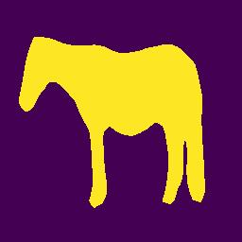
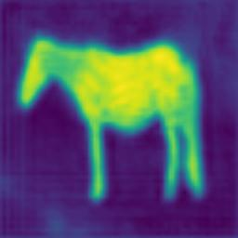
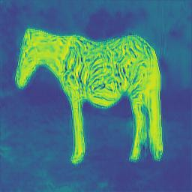
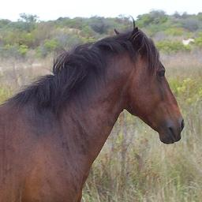
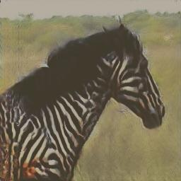

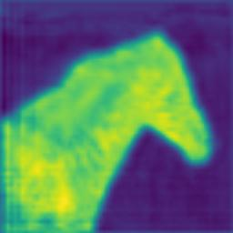
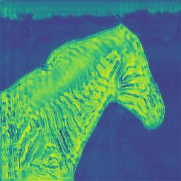
Results
Input
Output
Seg Map
Res-attn map
Dec-attn map

Slide 20
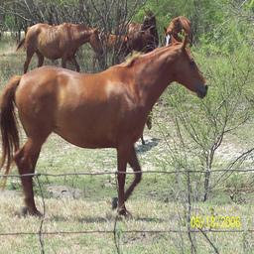
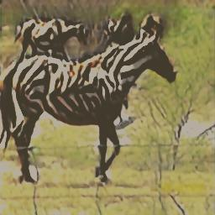
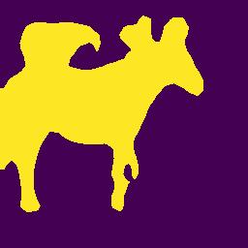
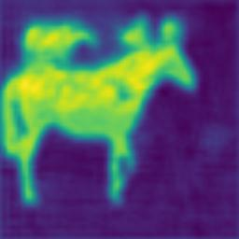
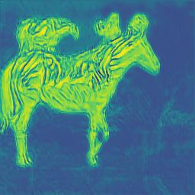
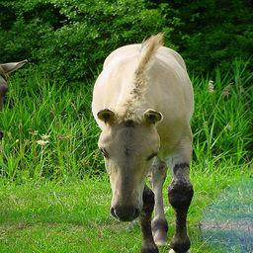
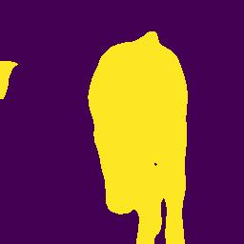
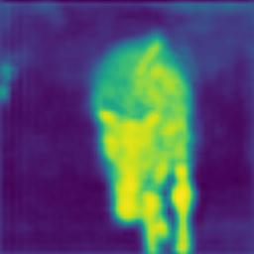
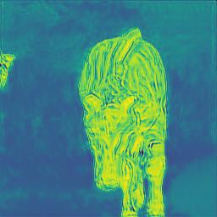
Results (Cont.)
Input
Output
Seg Map
Res-attn map
Dec-attn map

Slide 21










Results (Cont.)
Input
Output
Seg Map
Res-attn map
Dec-attn map

Slide 22





Results (Cont.)
Bad segmentation = Bad translation
Input
Output
Seg Map
Res-attn map
Dec-attn map

Slide 23





Results – Comparison
Input
Segmentation Map
W/O Segmentation
Segmentation

Slide 24








Results – Comparison (Cont.)
Input
Segmentation Map
W/O Segmentation
Segmentation

Slide 25
Conclusions
The integration of segmentation-guided attention significantly improves the quality of the generated zebras by focusing on relevant features in the horse images, leading to more realistic and detailed outputs
The attention mechanism successfully directs the generator's focus to specific areas of the input images, enhancing the model's ability to generate better images compared to a standard CycleGAN
As future work, we can further refine the attention mechanism for improved performance
In addition, we can add more training examples from the internet to enhance the training
We can also try to detect the horse/zebra in an image and give it a score, based on it determine if to use this example or not
Finally, we can expand to other domains, such as satellite-to-map, etc.

Slide 26
The End
Thanks for listening!

Slide 27


Loss Functions
Generators’ Loss Curves
Overall Loss Curves

